Slide 1
Differences in Muscle Hypertrophy
Charis Buck

Slide 2
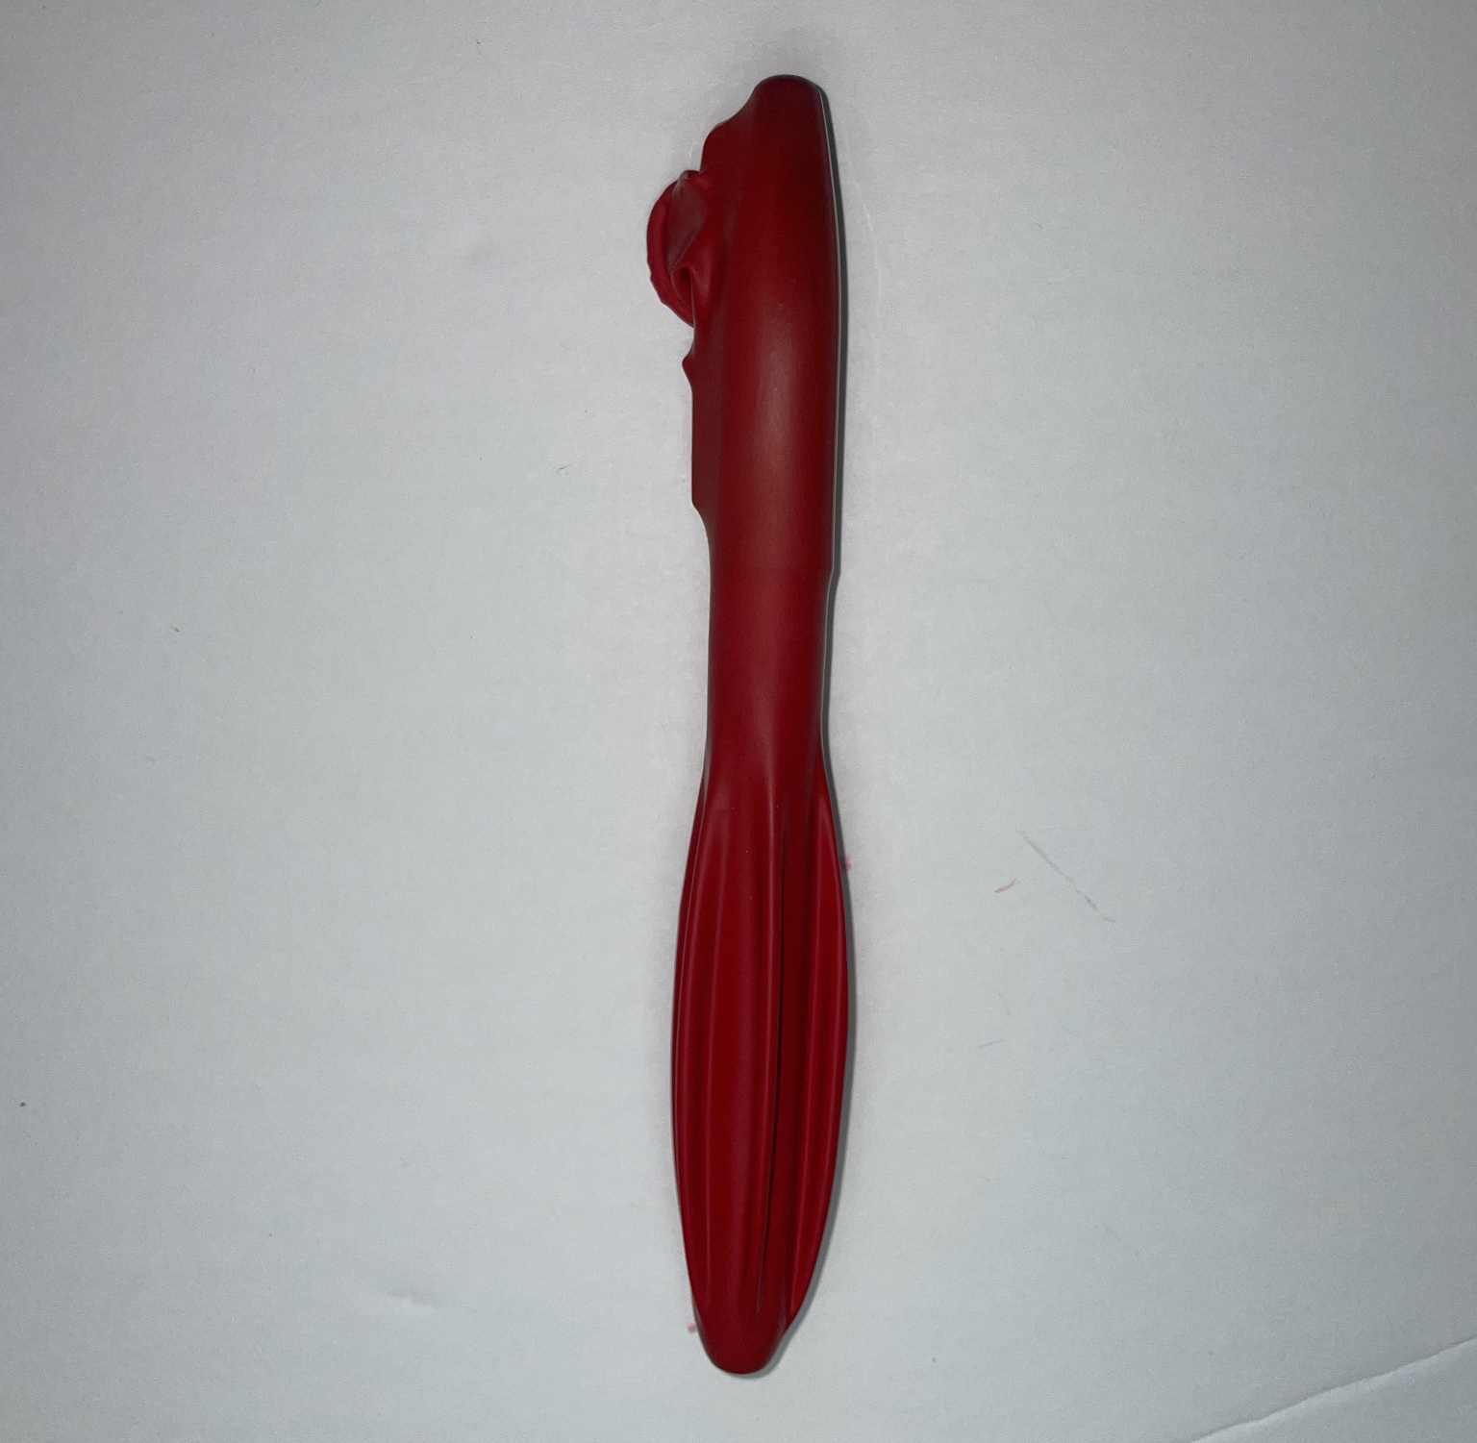
This balloon represents an individual muscle fiber, and the pen inside represents a myofibril. There is also a little bit of water inside, this represents sarcoplasm.

Slide 3
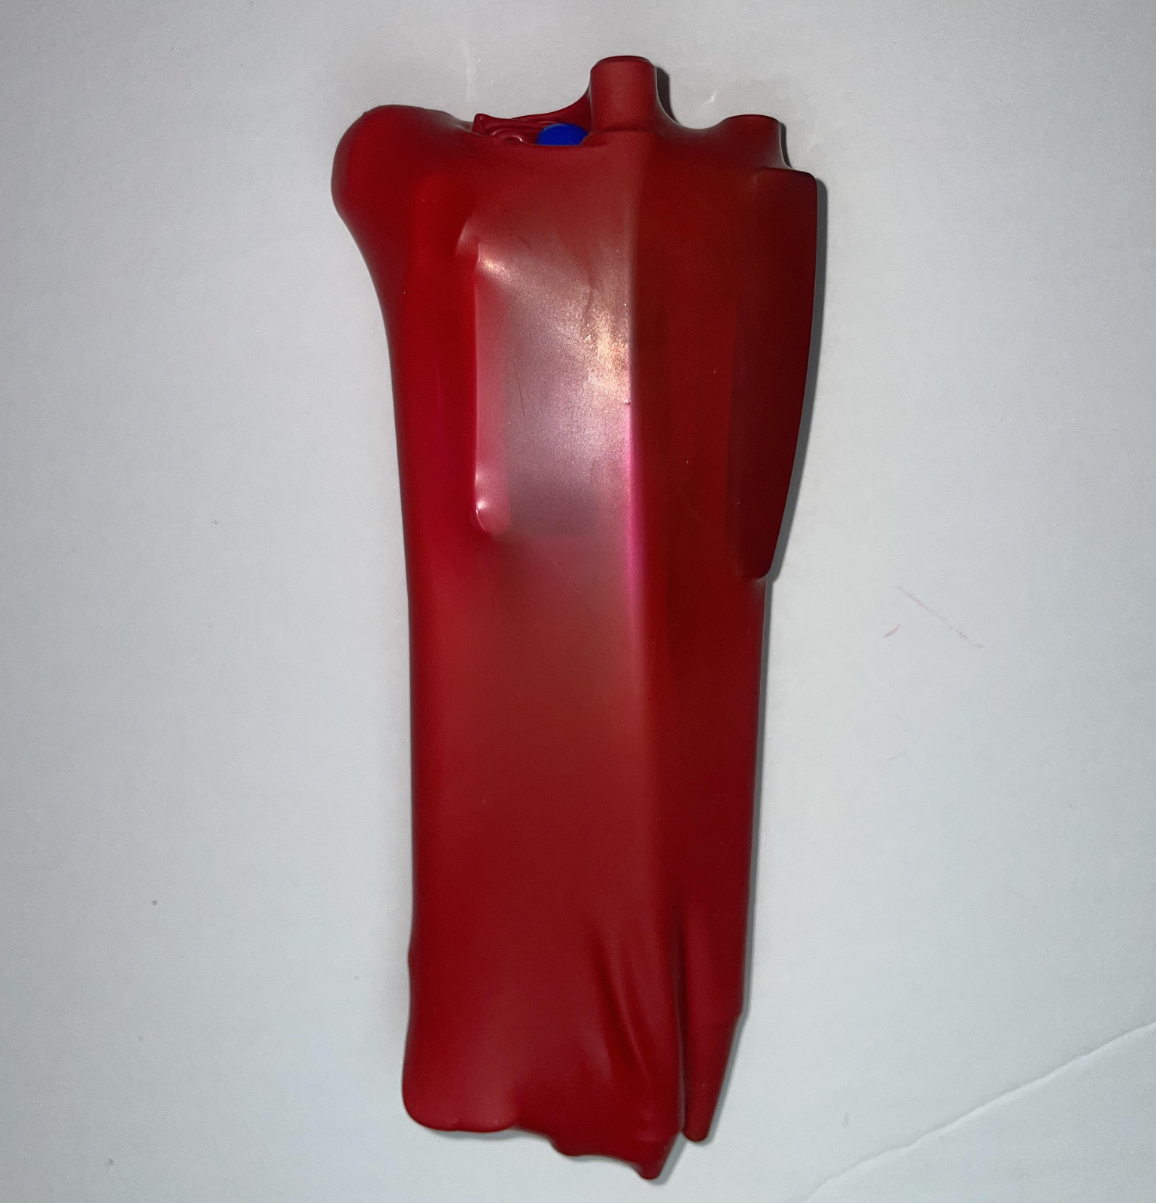
Myofibrillar hypertrophy is the growth of muscle contraction parts, this is like adding more pens inside the balloon. This is achieved mostly through doing low repetitions of high weight exercises. This increases the contractile units within the muscle fiber, overall increasing your strength.

Slide 4
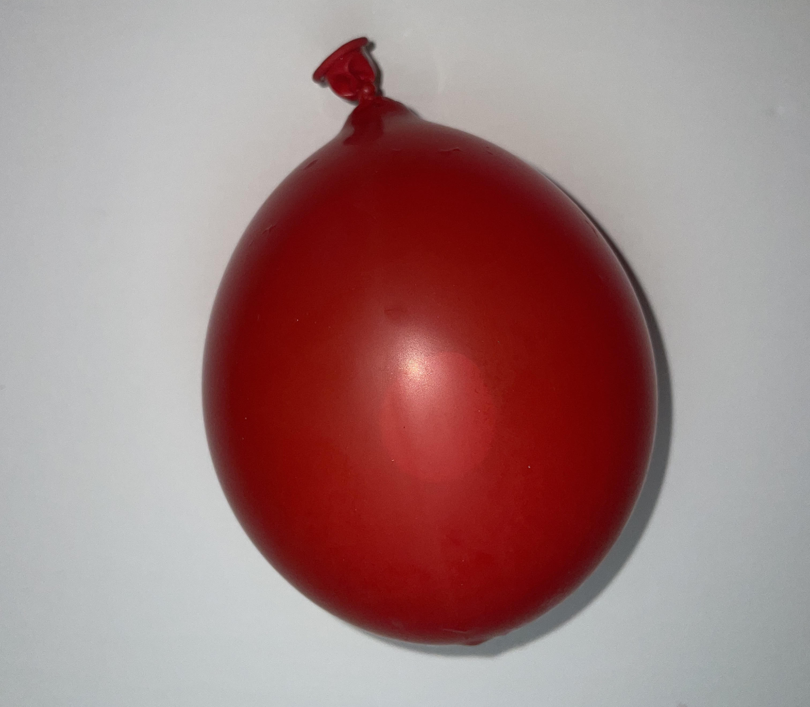
Sarcoplasmic hypertrophy is increased muscle glycogen storage, this is like adding more water to the balloon. This type of hypertrophy comes from doing high repetitions of lower-weight exercises. This increases the workload that myofibrils can perform, which adds muscle endurance.

