Slide 1
Steam Project:
The steam project was an interesting way to connect with the human body. It expanded my thinking about similarities between our bodies and the world around us. The course content I will be connecting my project to is all the different types of tissues; epithelium, connective, cartilage, blood and cardiac muscles and tissues. How I will be connecting them is through the objects in my home. For example, I have wood floors and a lot of the tissue designs correlate with the design of wood. Another example is granite countertops, they also identify closely with certain tissues. After I connect the tissue with the house object, I will explain the function of these tissues and bridge together similarities between everyday life and the objects surrounding us with the tissues in our body that support us.

Slide 2
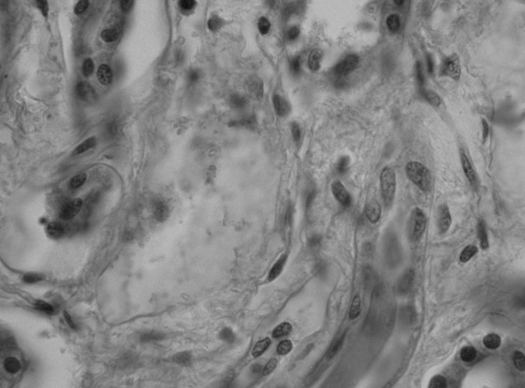
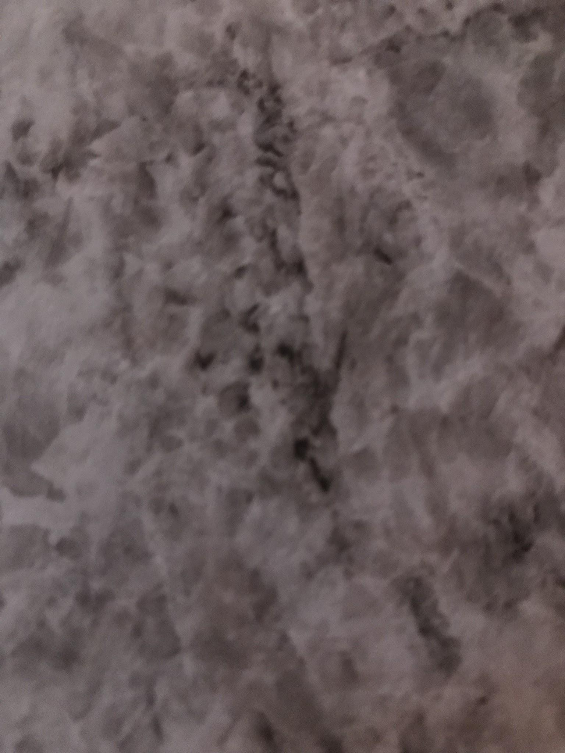
Simple Squamous:
Simple squamous epithelium. I used the countertop for the connection because obviously there are similarities in the way it flows and if you look carefully enough you can make out the nuclei, which is an important part in this tissue. Simple Squamous is the lining in the blood vessels (Endothelium) and body cavities (Mesothelium). For body cavities, to be a little more specific, the ventral and dorsal cavities. Simple Squamous is a single fattened cell that protects certain organs in our body. Simple Squamous allows the membranes to transfer easily because of how thin the cell is and it also plays a huge role in keeping the area it’s protecting clean, through filtering toxins and bacteria.
Simple Squamous
Countertop

Slide 3
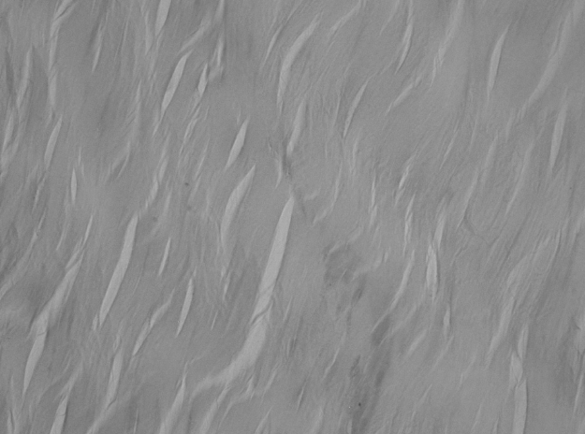
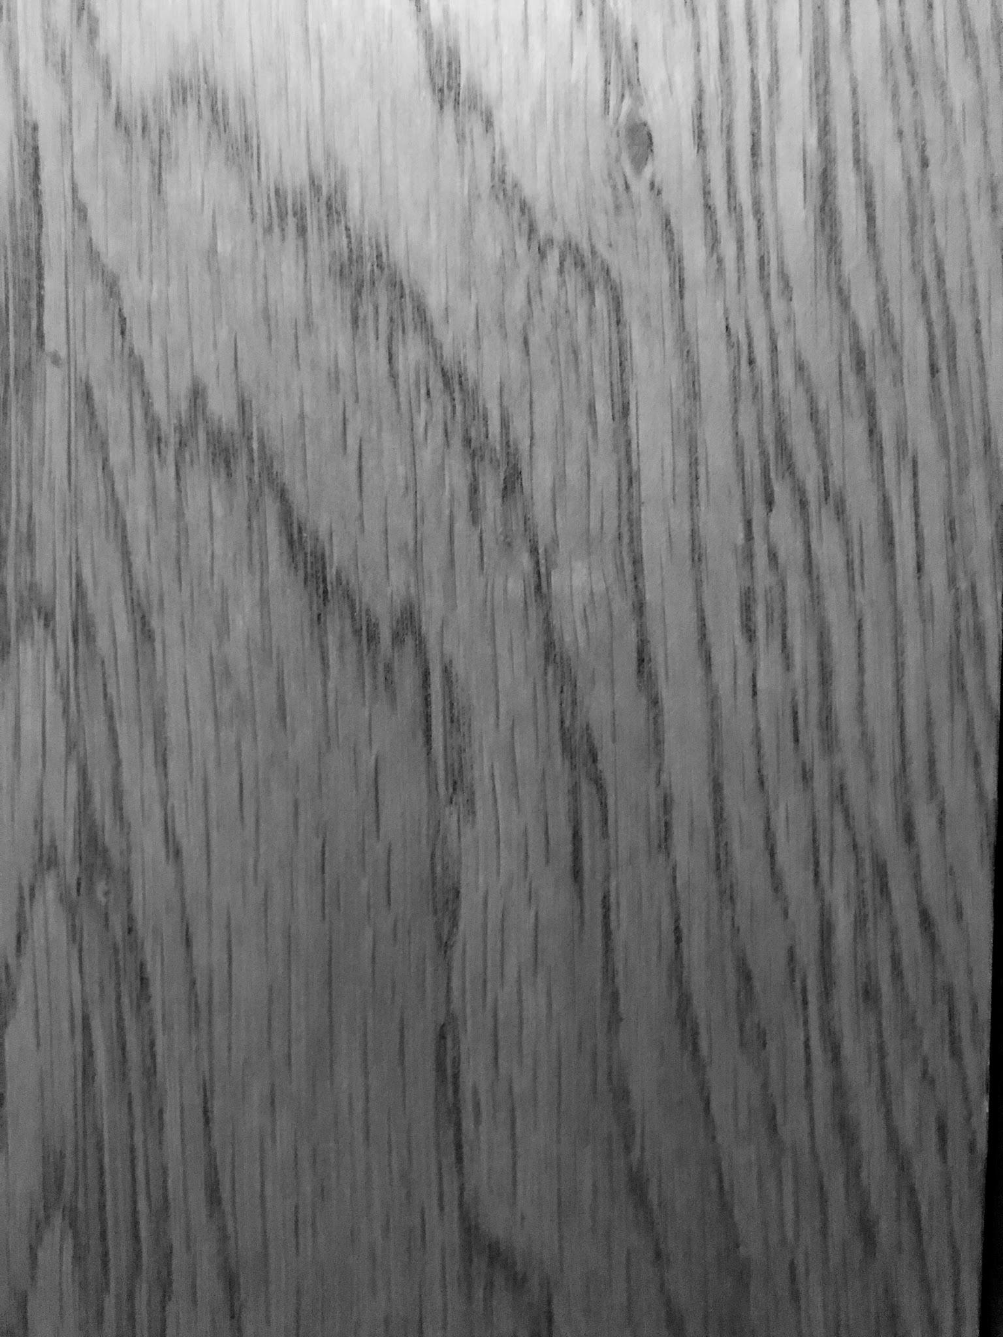
Connective Tissue
Pantry Door
Connective Tissue:
Dense regular connective tissue. I found this resemblance on the pantry door while I was taking a lunch break. I was struggling to find an object that looked like this tissue so I decided to do something that was more appealing to me, eating. That's when I found the connection. These are the robust tissues, strong and powerful as they need to be. These tissues are made up of a single fiber (collagen fiber) . These fibers are very compact and sturdy, hence the name (dense tissue). They are this way because of their structure and function. These tissues are found in areas of the body that require the most tensile strength, where the muscles are tested and stretched to their limit. The tissue is also flexible, allowing the most mobility to the tendons and ligaments as possible. Every fiber in this tissue runs in the same parallel direction, in the direction where the force from the tendons and ligaments are coming.

Slide 4
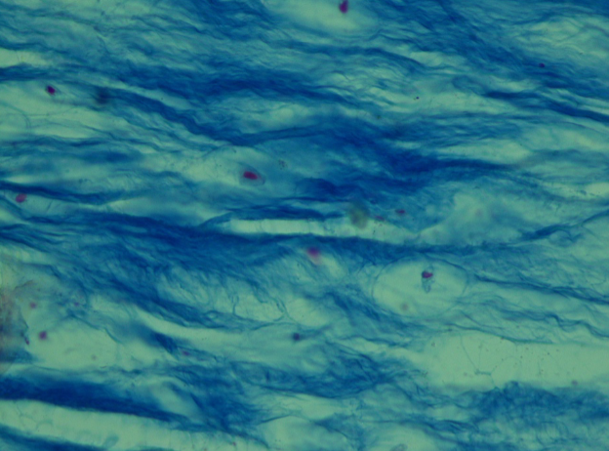
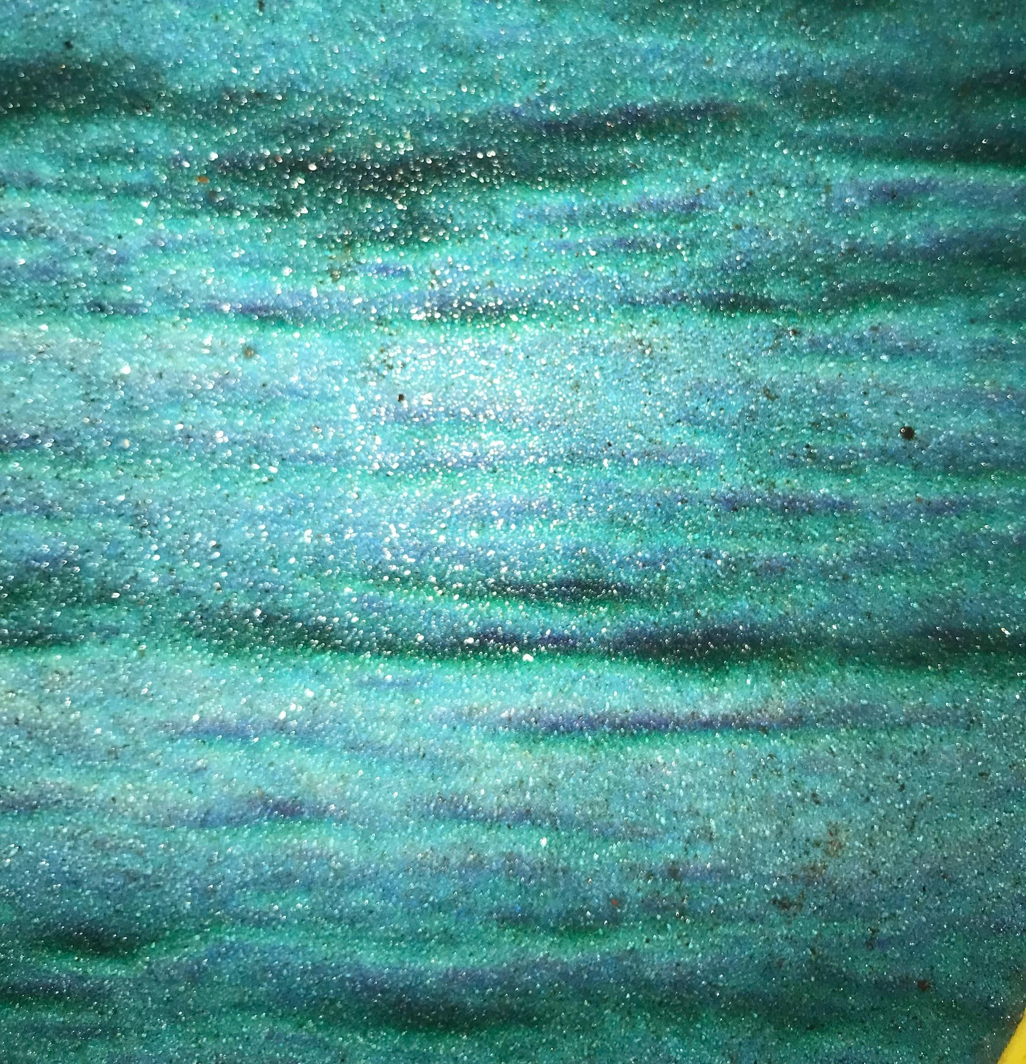
Here we have the Cartilage Fibrocartilage tissue.
Cartilage fibrocartilage. I found the look of this tissue on the skateboard that I bought when I was twelve. This tissue is also very durable, found supporting the intervertebral disks and at the entrance of tendons and ligaments. This tissue appears white but it is also smaller than most tissues. This tissue could be seen as a mixture between the dense connective tissue and the hyaline cartilage tissue because of the way it looks and how it is structured. Fibrocartilage contains many collagen fibers and is compact which is the opposite of the hyaline cartilage that is soft and contains very few fibers. Overall this is a very strong supportive tissue that allows your muscles to move at the best of their ability.
Fibrocartilage
Skateboard

Slide 5
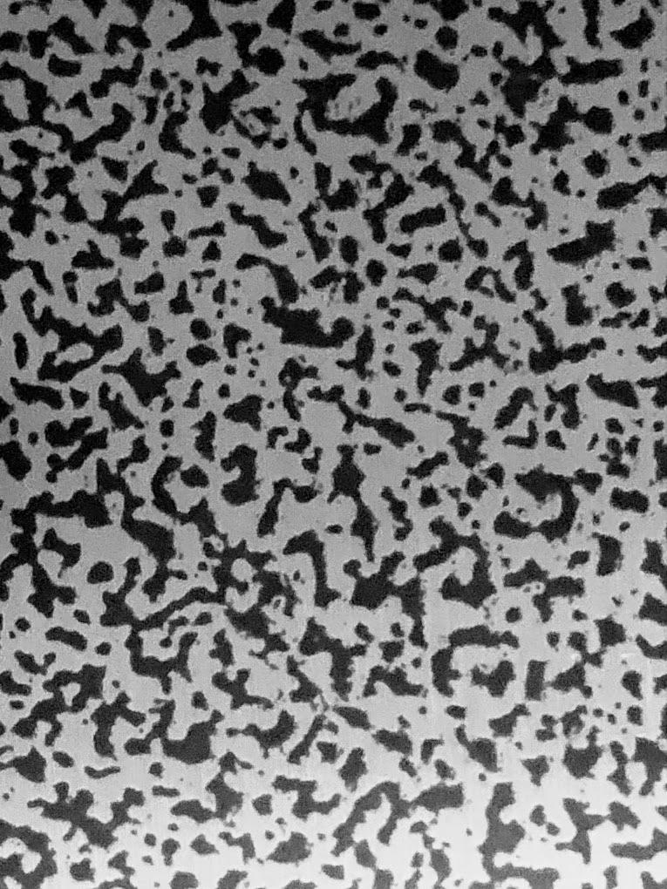
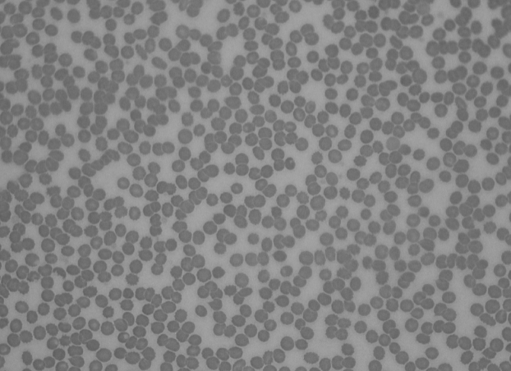
Grandfather Clock
Blood at 400TM
This is a blood at 400TM. Blood tissue is one of the connective tissues. I found this connection on our grandfather clock. The connective tissues contain a lot of cells. And those cells contain oxygen, and that oxygen in these types of tissues are transported into our lungs and other tissues. This provides a healthy vascular system and strong tissues throughout our body.
Fun Fact: blood is the only liquid tissue in the body that is accountable for about ten percent of the human body weight.
Blood at 400TM

Slide 6
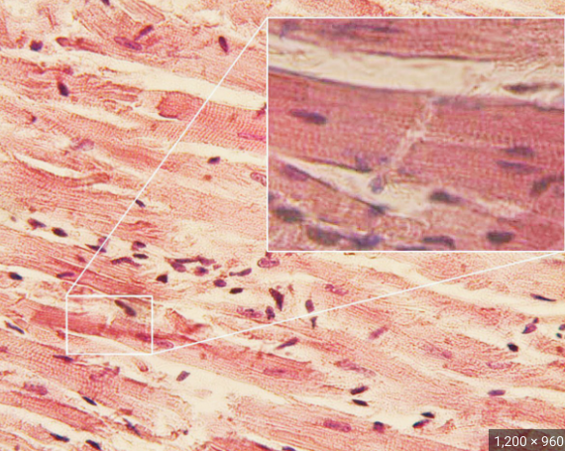
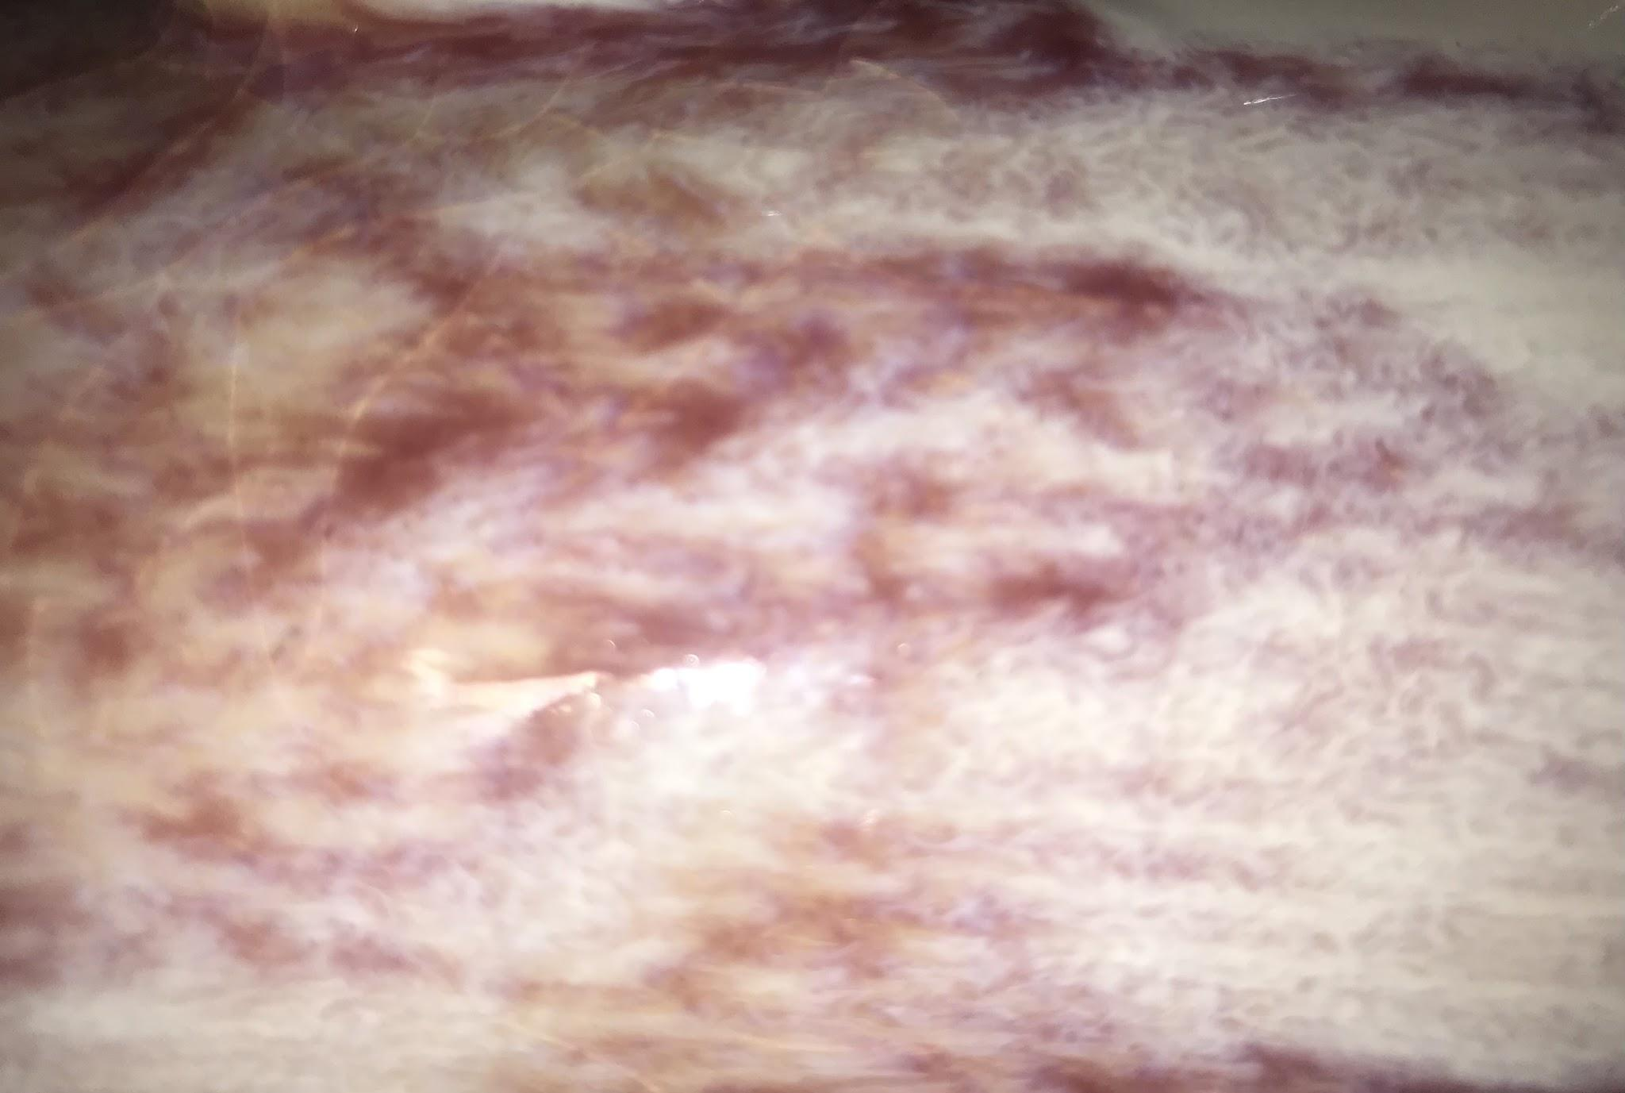
This is the Cardiac Muscle:
Cardiac Muscle
Cardiac muscle. I found a flower vase to connect the look of the cardiac muscle. The cardiac muscle is found in the wall of the heart. This muscle makes up a certain type of tissue called ‘myocardium’. This tissue makes up a thick layer of the wall surrounding the heart. These tissues contain a number of cells, these cells expand and contract to work as impulses from the nervous system. This makes what we call the ‘heartbeat’. A rhythmic contraction function. The cardiac muscles responsible for the contraction of the heart. The cardiac muscle has to create enough force to pump the blood through the entire body.
Flower Vase

Slide 7
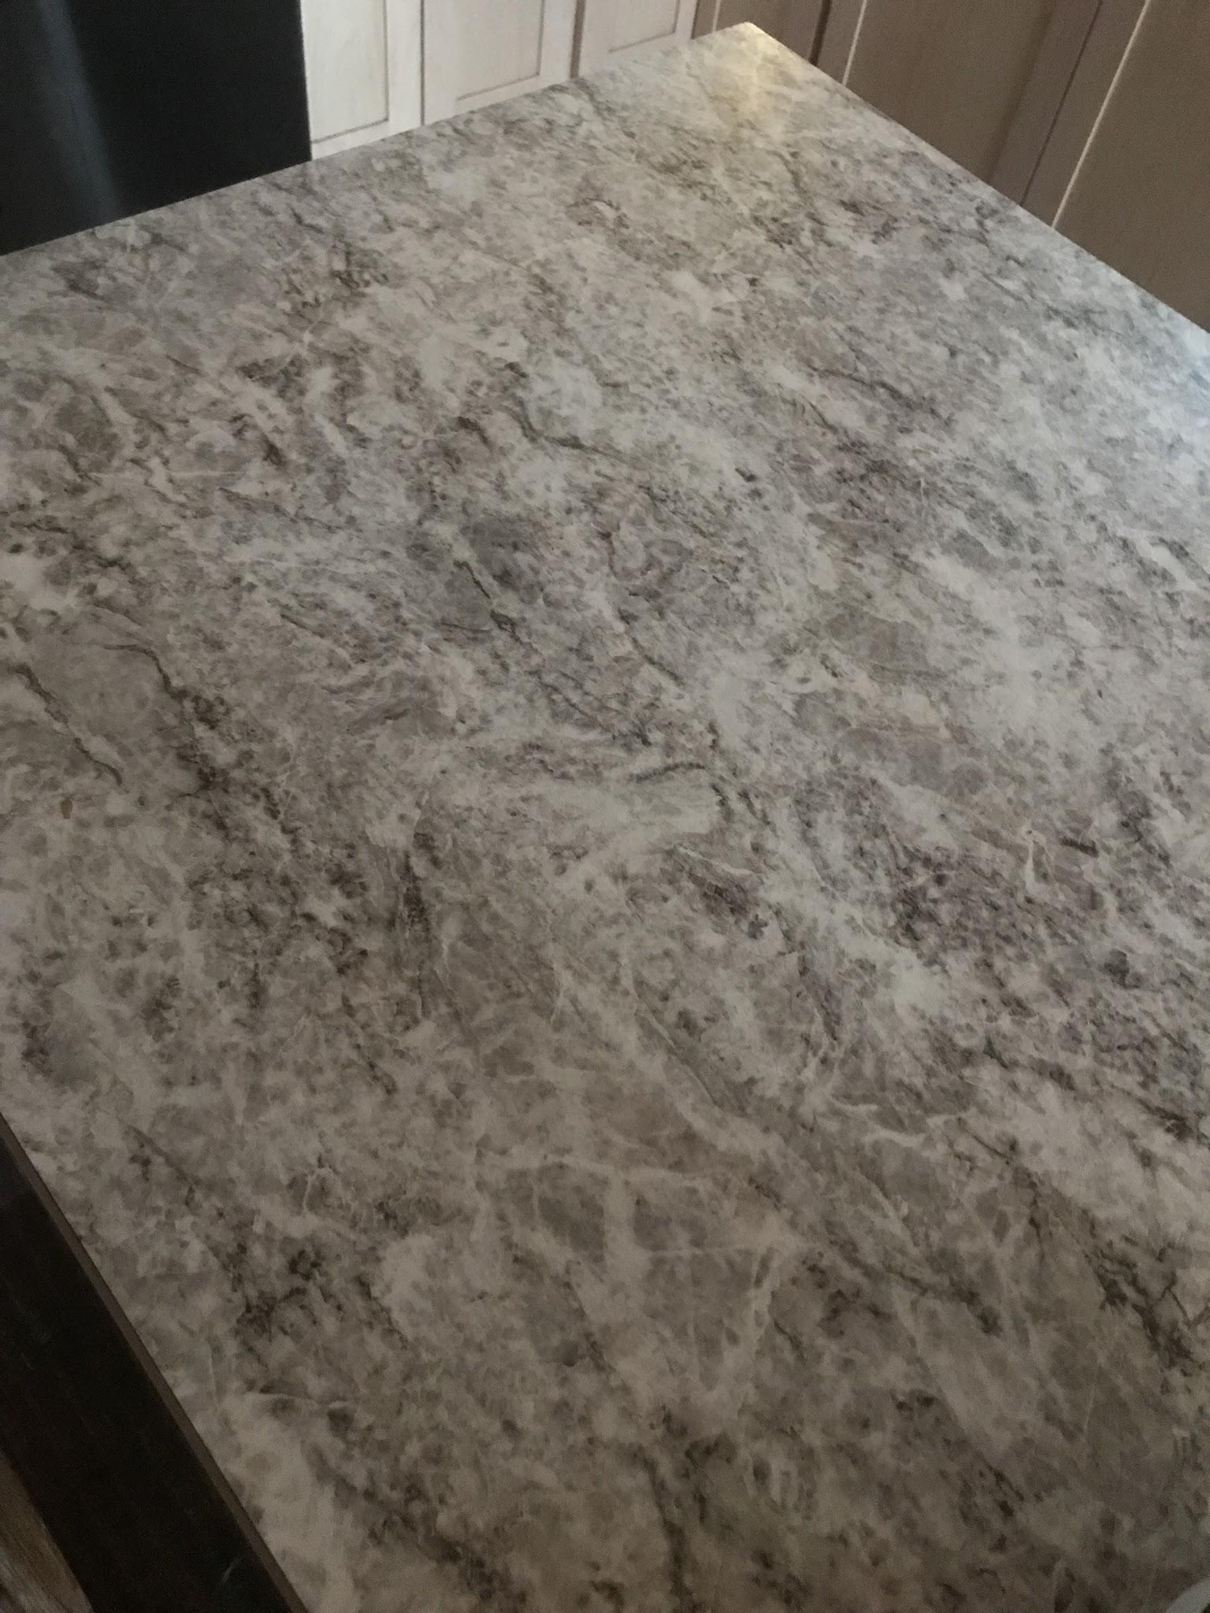
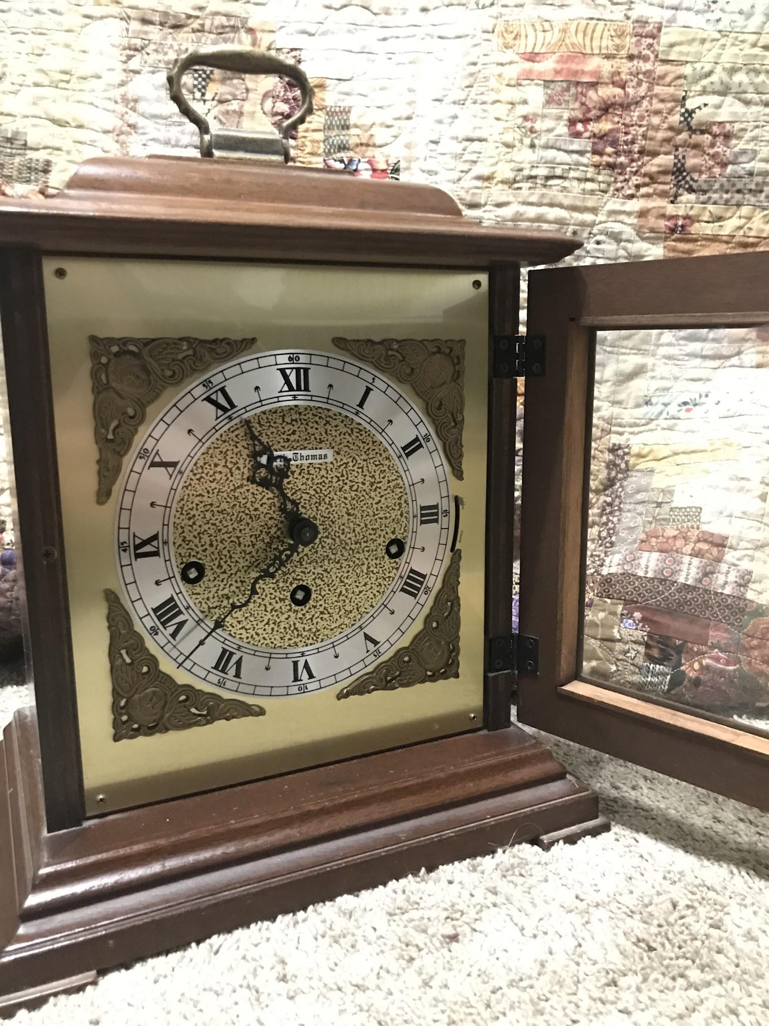
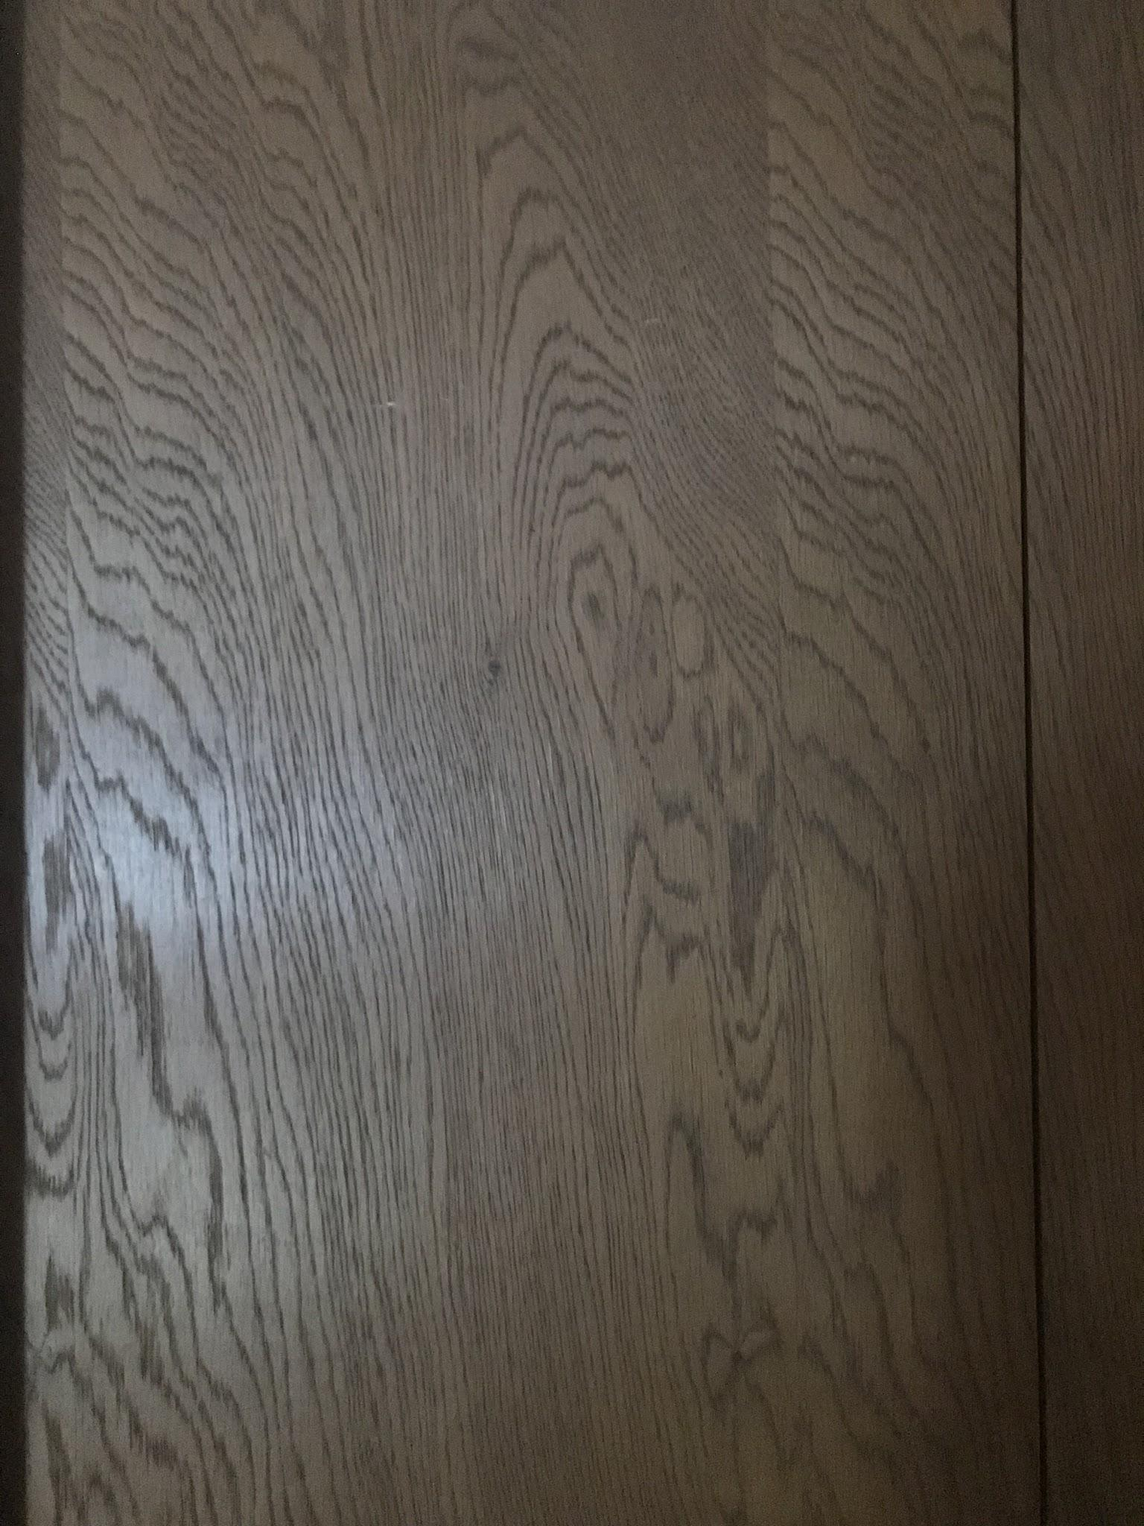
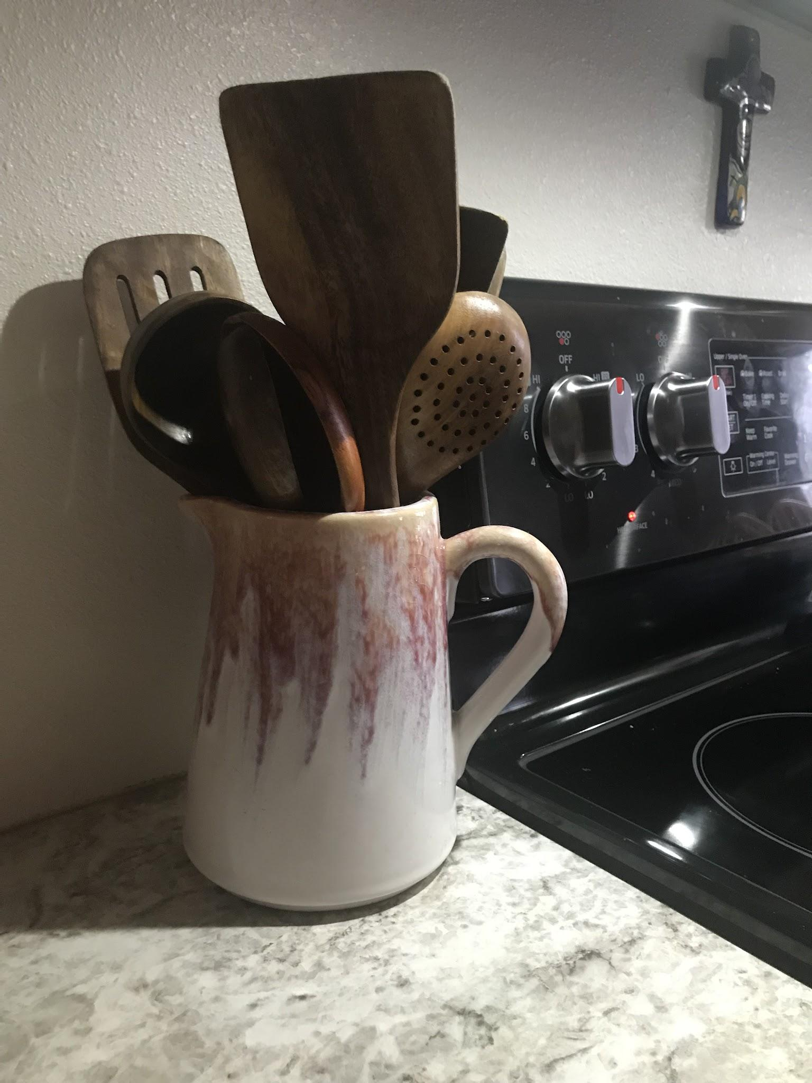
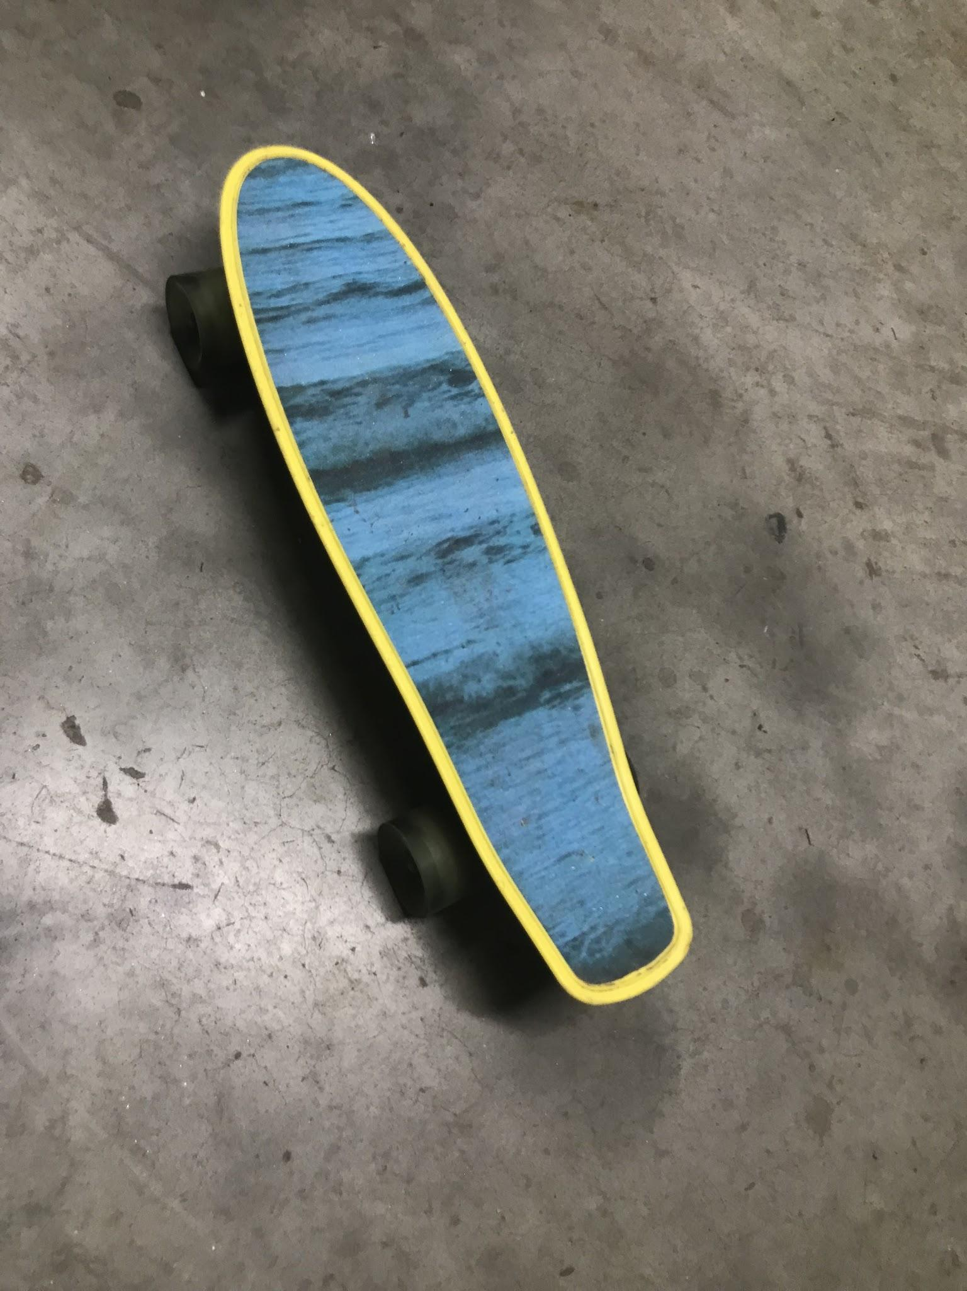
Everything has a purpose, but sometimes it’s hard to see what that purpose might be, so maybe we just need to start looking from a different perspective. By doing this we can break down the functions of life and know how to use them correctly. It’s the same thing with muscles, tissues and cells. If we can learn how all these things function and the special way they support our body, we can change some of our unhealthy habits into habits that not only help our daily lives and momentary feelings but the longevity perspective of it. Finding connections can help awareness so we can learn to support all the different areas of our bodies.

Slide 8
Finding connection in the world serves as a learning method, the same way as creating a mnemonic to help you remember a definition. These slides are my example of finding things in my life that will help me connect the material I’m learning in this course.
Thank you, Nathan.

